Slide 1
WDD/OSWS Project
Alexander Ang – 201906L

Slide 2
Content
Homepage
About
Contact
View Products – View All/More
Recipe
Search Product
Register
Login
Cart – Add/Remove/Checkout
Edit Profile – Change Password/Change Address/Logout
Manage Orders – Cancel Order/Update Delivery Status/Order Status

Slide 3
Sitemap
Homepage
Home
View Products
Recipes
Search
Login/Register
Cart
Products
Noodles
My Account
View More/All
Pairings
My Purchases
Wrappers
Logout
Condiments
Address
Profile
Change Password
View Order History
Cancellation
Update Order Status

Slide 4
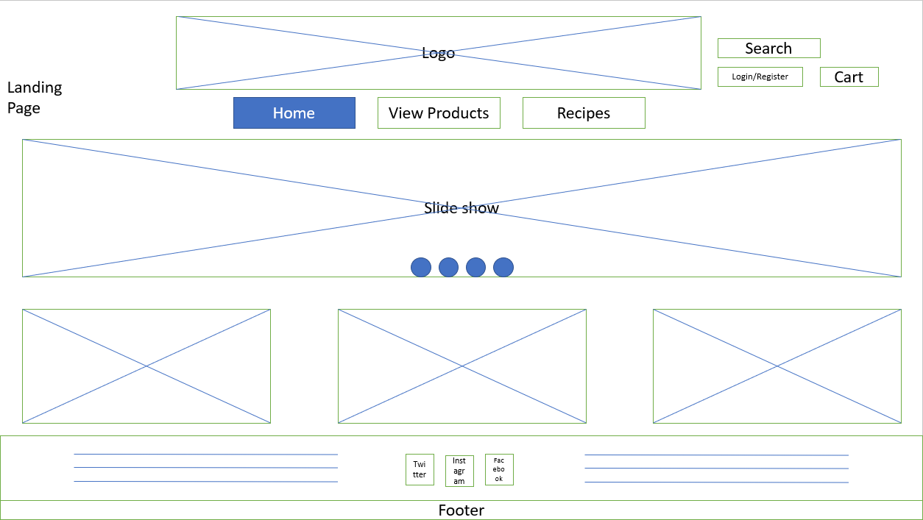
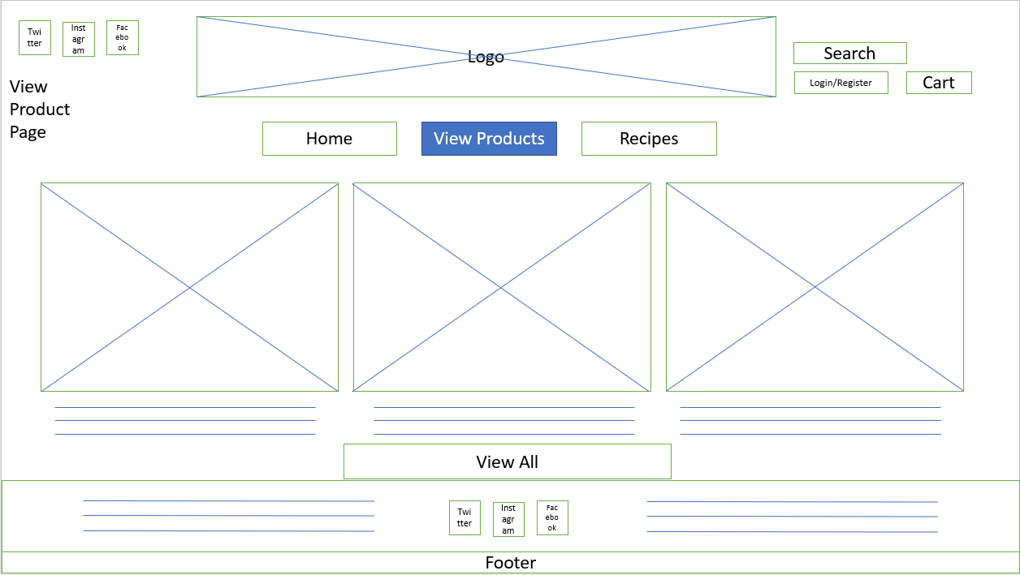
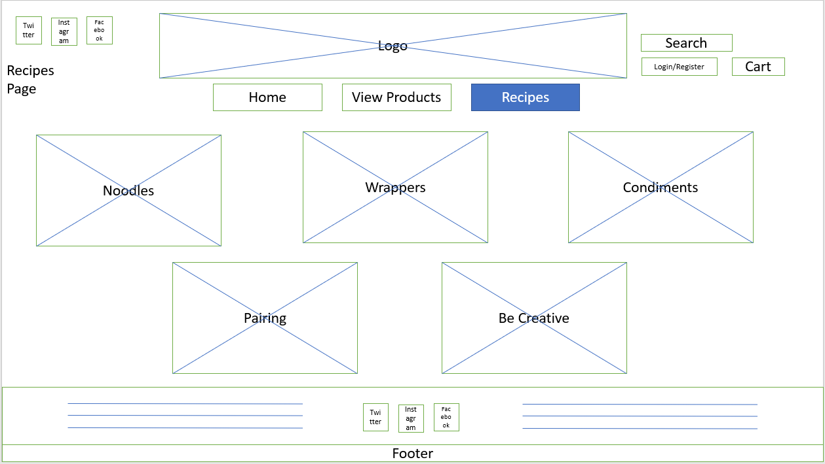
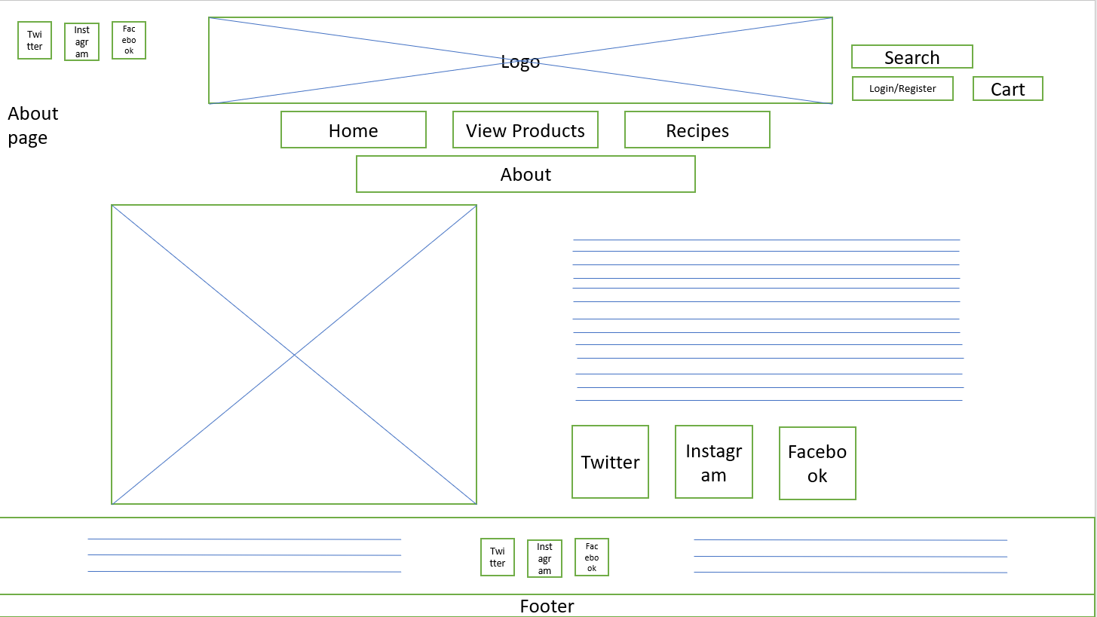
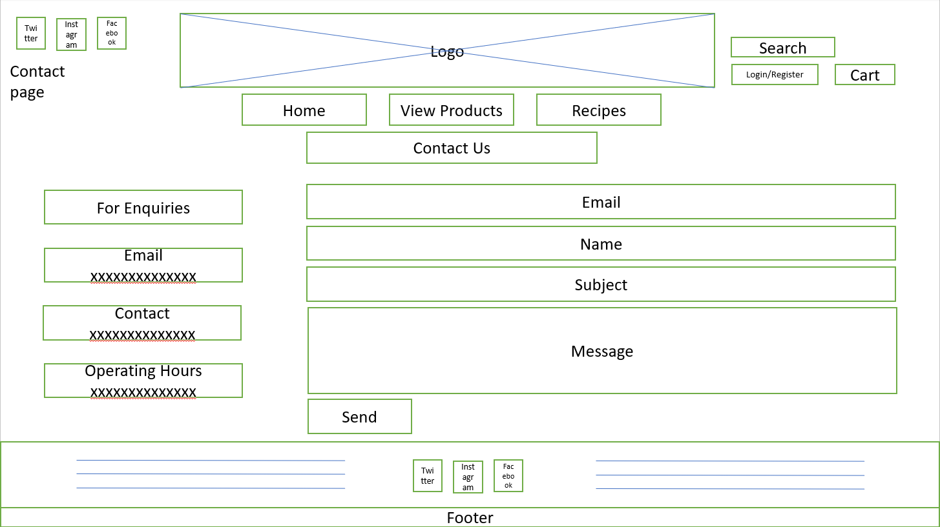
Storyboard
View Products page and Recipes page can also visit Login/Register and Cart page, About and Contact
Homepage can visit Login/Register, Cart, View Products, Recipes, About and Contact
About and Contact Page are located above the footer

Slide 5
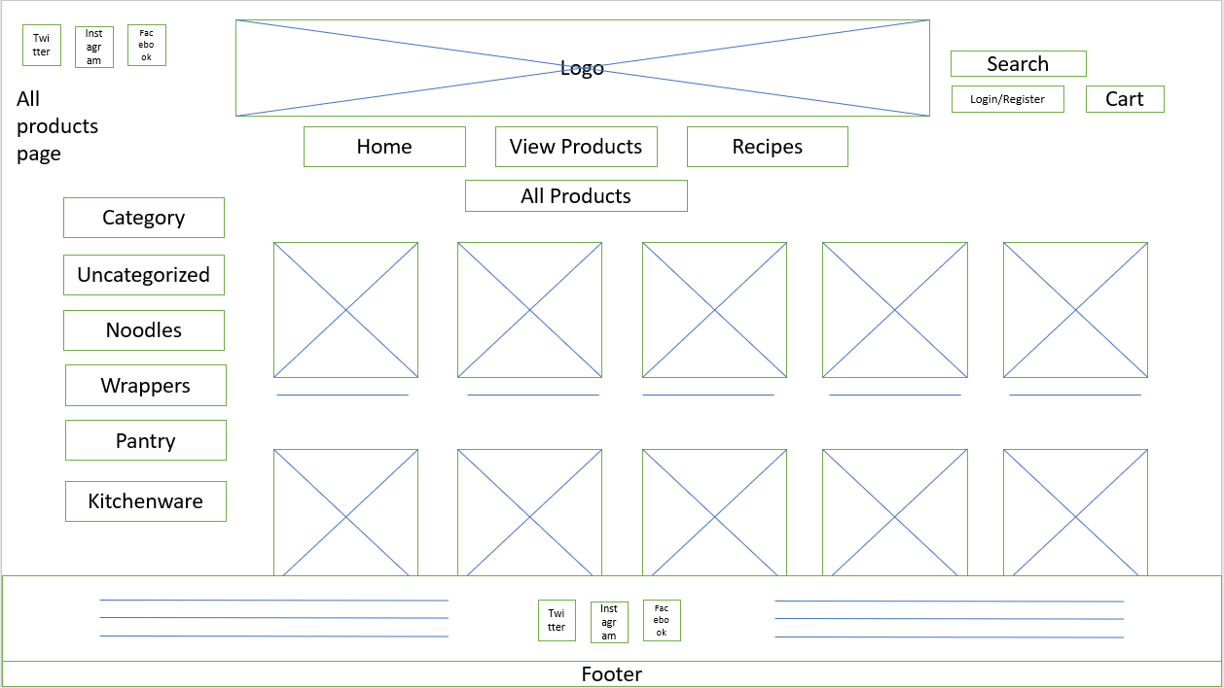
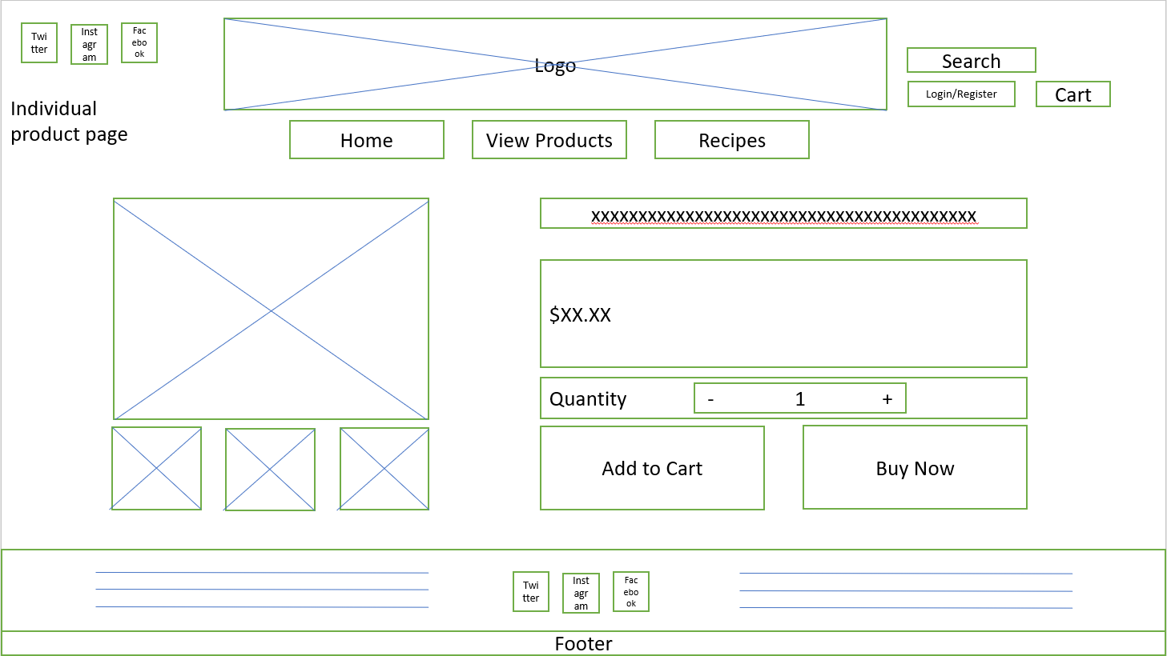
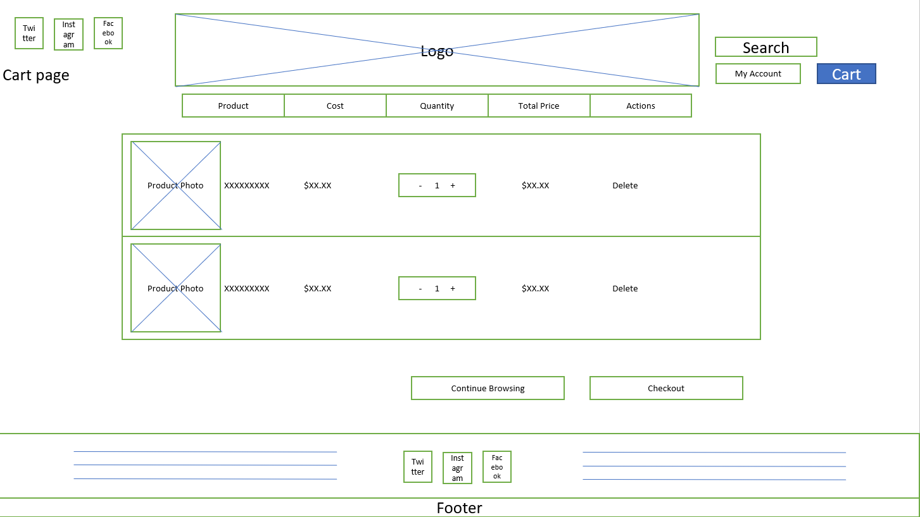
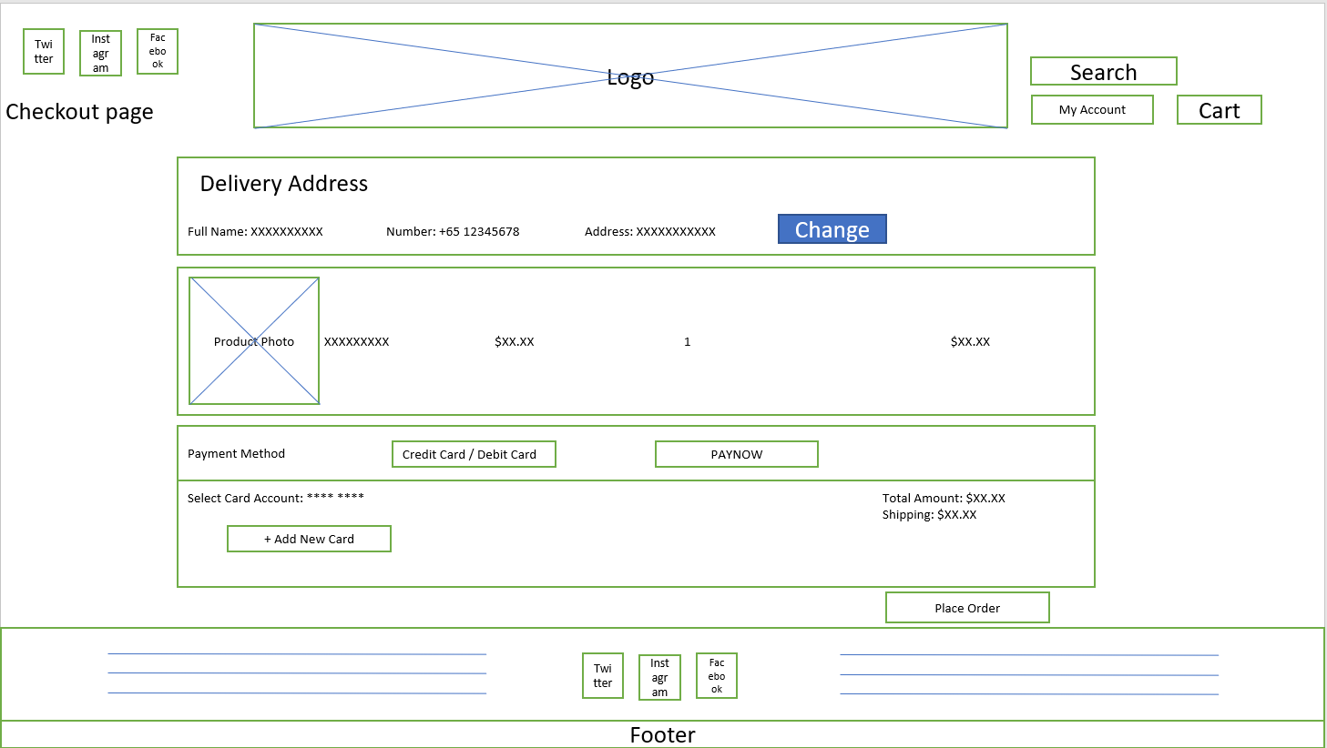
Storyboard
The view products page will show the top 3 items.
View All button will lead to more variety of items
The view all products page will display individual items and will have a category section at the side
Clicking on an item will bring it to the item page where you can add to cart or buy now where you can also adjust the quantity
Upon clicking buy now, it will add the item into cart and bring it to place order (buy item)
Upon clicking buy now, will add items into card to confirm and checkout, directing to place order page, or upon clicking continue browsing will redirect to All products page

Slide 6
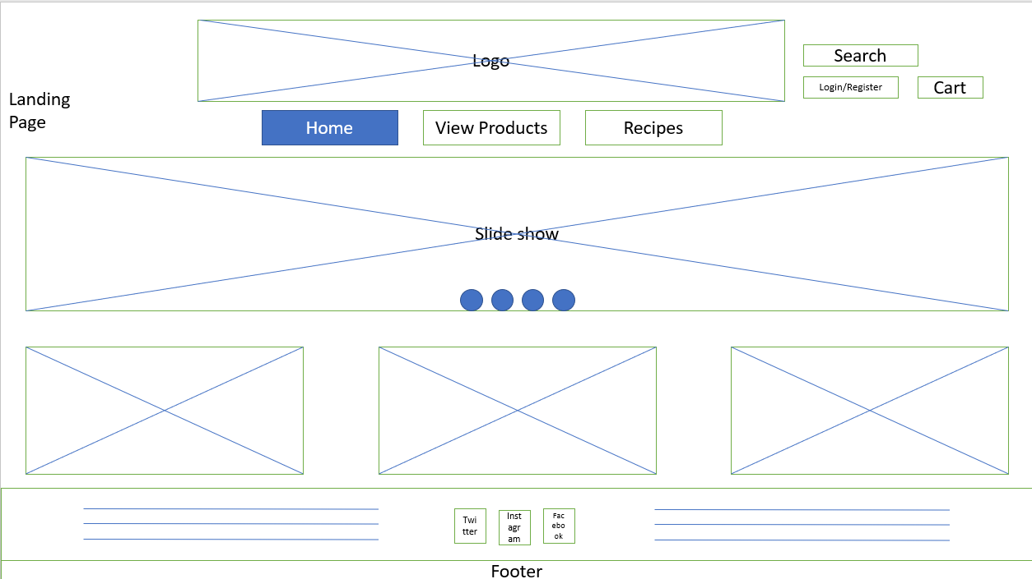
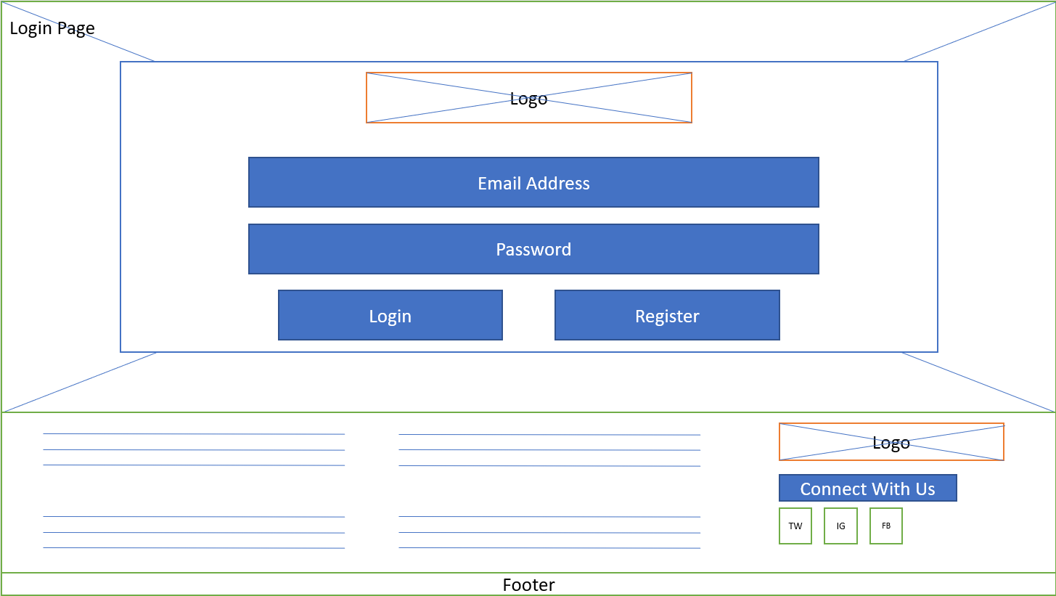
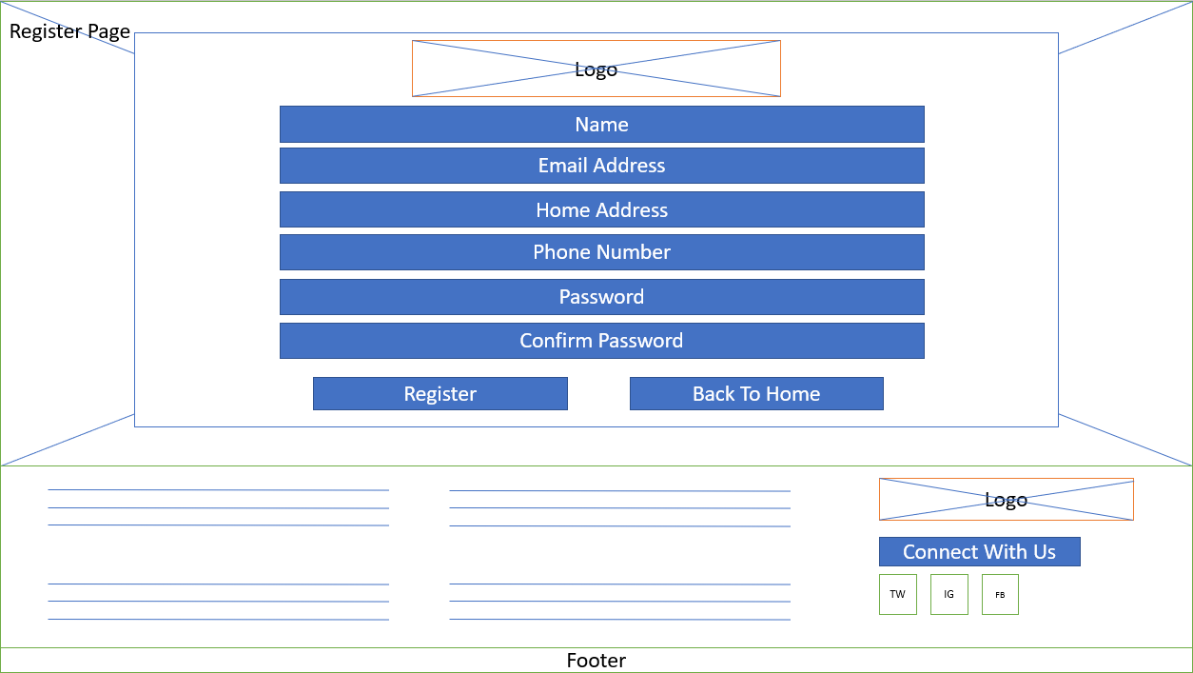
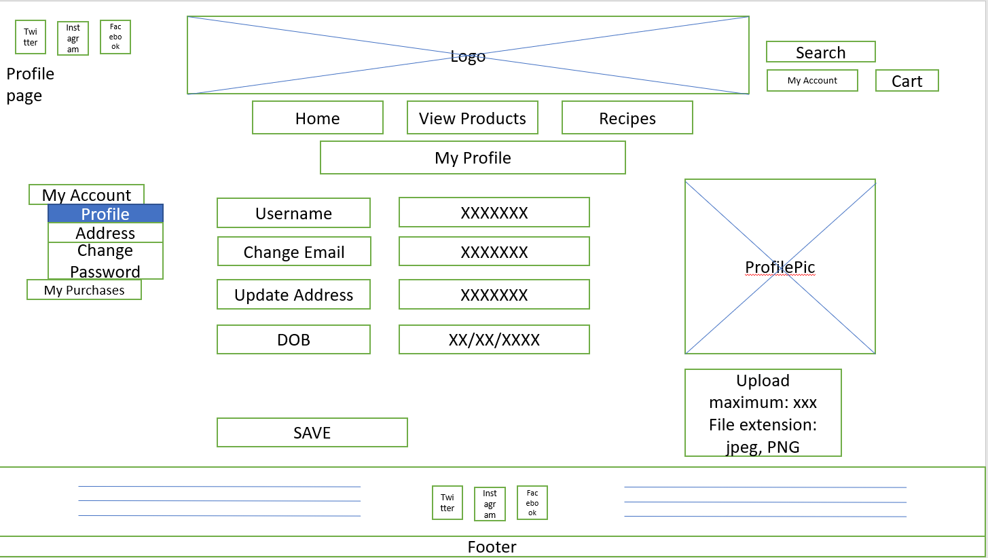
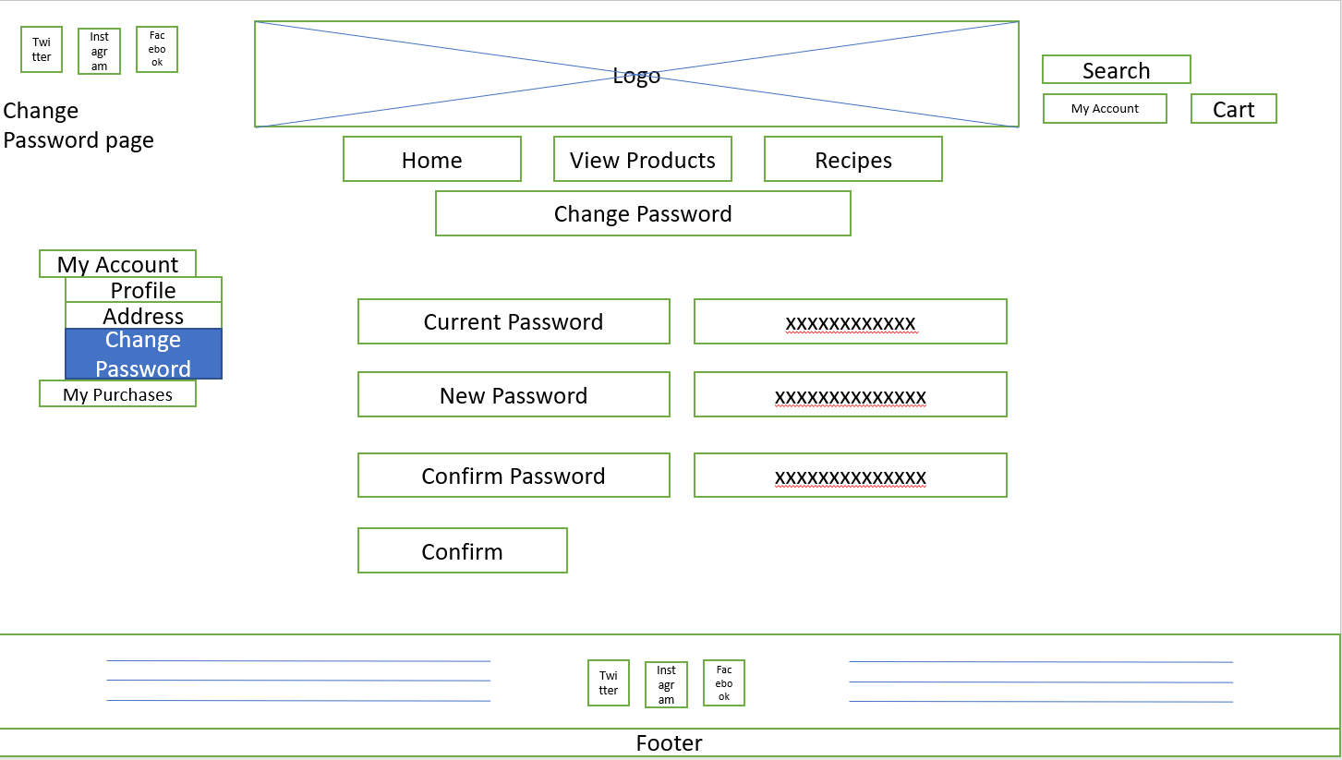
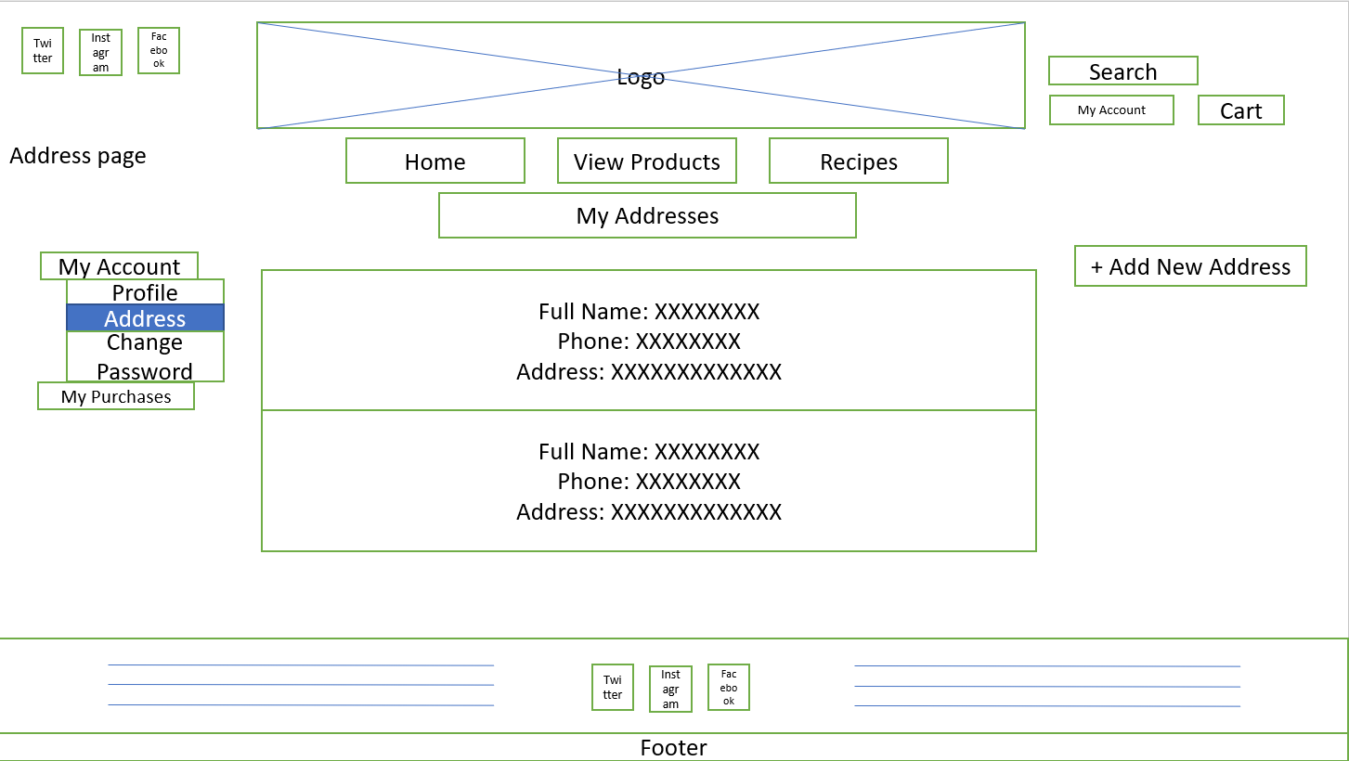
Storyboard
From homepage, can visit login and register page through Login/Register button
From login page, upon login will direct back to home page for members, else will direct to register page
Upon registering, will direct to Homepage
Upon registering or login, members can access My Account page
Through My Account, can change password/addresses etc…

Slide 7
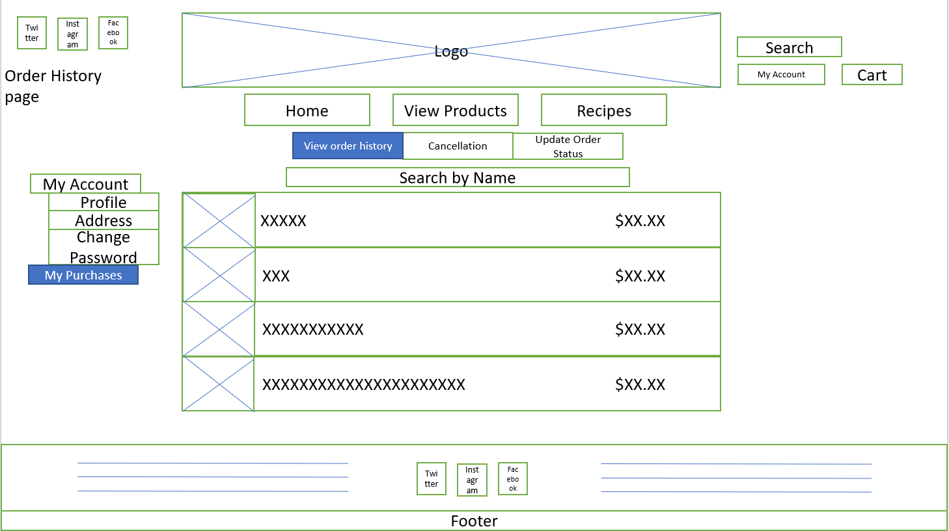
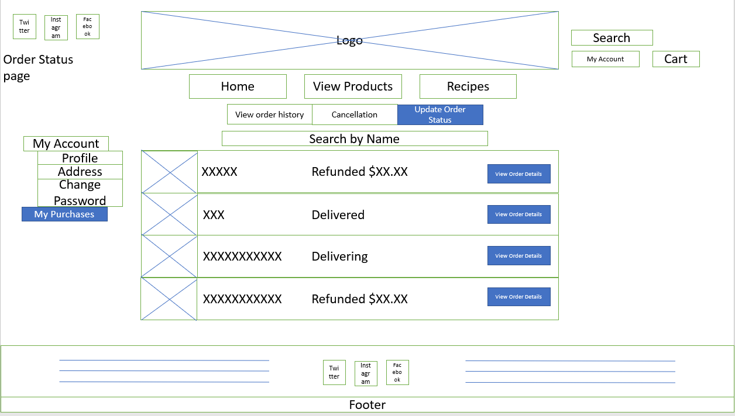
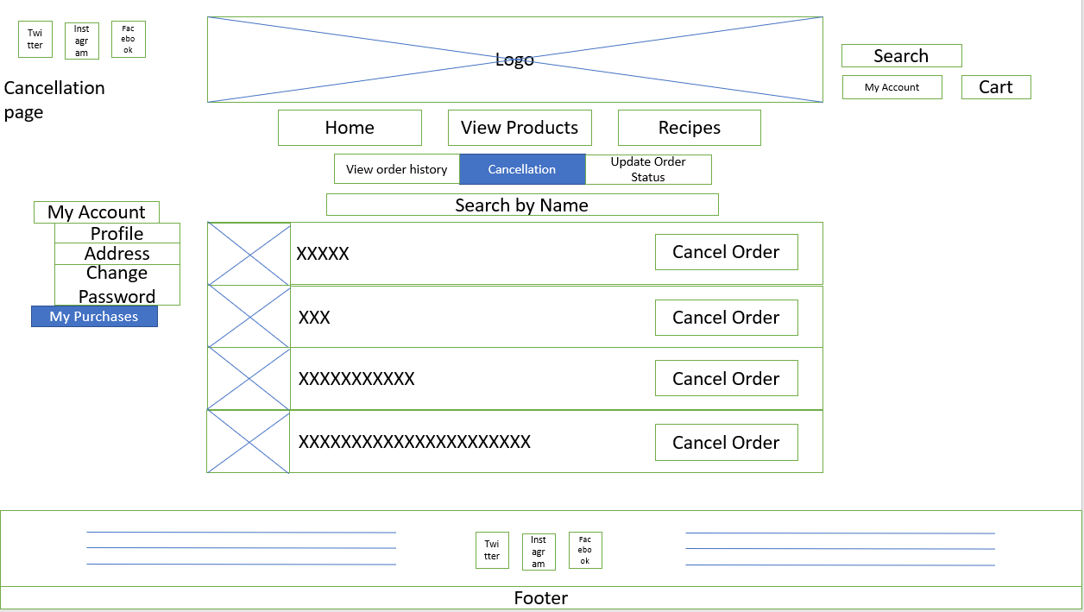
Storyboard
Under My Purchases, can View Order History, Cancellation and Update Order Status. Can navigate throughout

Slide 8
Wireframe

Slide 9
Logo
Mobile
Search
SlideShow
Photolink 1
PhotoLink2
Footer

Slide 10
Logo
Tablet
Search
SlideShow
Photolink 1
PhotoLink2
Footer

Slide 11
Logo
Login/Register
Landing Page
Search
Cart
Home
View Products
Recipes
Slide show
Twitter
Instagram
Facebook
Footer

Slide 12
Twitter
Instagram
Facebook
Logo
Login/Register
View Product Page
Search
Cart
Home
View Products
Recipes
View All
Twitter
Instagram
Facebook
Footer

Slide 13
Twitter
Instagram
Facebook
Logo
Login/Register
Recipes Page
Search
Cart
Home
View Products
Recipes
Noodles
Wrappers
Condiments
Pairing
Be Creative
Twitter
Instagram
Facebook
Footer

Slide 14
Twitter
Instagram
Facebook
Logo
Login/Register
All products page
Search
Cart
Home
View Products
Recipes
All Products
Category
Uncategorized
Noodles
Wrappers
Pantry
Kitchenware
Twitter
Instagram
Facebook
Footer

Slide 15
Twitter
Instagram
Facebook
Logo
Login/Register
Individual product page
Search
Cart
Home
View Products
Recipes
xxxxxxxxxxxxxxxxxxxxxxxxxxxxxxxxxxxxxxxxx
$XX.XX
Quantity
- 1 +
Add to Cart
Buy Now
Twitter
Instagram
Facebook
Footer

Slide 16
Twitter
Instagram
Facebook
Logo
Login/Register
Search
Cart
About page
Home
View Products
Recipes
About
Twitter
Instagram
Facebook
Twitter
Instagram
Facebook
Footer

Slide 17
Twitter
Instagram
Facebook
Logo
Login/Register
Contact page
Cart
Search
Home
View Products
Recipes
Contact Us
For Enquiries
Email
Name
Email xxxxxxxxxxxxxx
Subject
Contact xxxxxxxxxxxxxx
Message
Operating Hours xxxxxxxxxxxxxx
Send
Twitter
Instagram
Facebook
Footer

Slide 18
Login Page
Home
View Products
Recipes
Logo
Email Address
Password
Login
Register
Logo
Connect With Us
TW
IG
FB
Footer

Slide 19
Register Page
Home
View Products
Recipes
Logo
Name
Email Address
Home Address
Phone Number
Password
Confirm Password
Register
Back To Home
Logo
Connect With Us
TW
IG
FB
Footer

Slide 20
Twitter
Instagram
Facebook
Logo
My Account
My Profile
My Purchases
Logout page
Logout
Cart
Search
Home
View Products
Recipes
View All
Twitter
Instagram
Facebook
Footer

Slide 21
Twitter
Instagram
Facebook
Logo
Login/Register
Profile page
Search
Cart
Home
View Products
Recipes
My Profile
My Account
ProfilePic
Profile
Username
XXXXXXX
Address
Change Password
Change Email
XXXXXXX
My Purchases
Update Address
XXXXXXX
DOB
XX/XX/XXXX
Upload maximum: xxx
File extension: jpeg, PNG
SAVE
Twitter
Instagram
Facebook
Footer

Slide 22
Twitter
Instagram
Facebook
Logo
Login/Register
Search
Cart
Address page
Home
View Products
Recipes
My Addresses
My Account
+ Add New Address
Profile
Full Name: XXXXXXXX
Phone: XXXXXXXX
Address: XXXXXXXXXXXXX
Address
Delete
Change Password
My Purchases
Full Name: XXXXXXXX
Phone: XXXXXXXX
Address: XXXXXXXXXXXXX
Delete
Twitter
Instagram
Facebook
Footer

Slide 23
Twitter
Instagram
Facebook
Logo
Login/Register
Change Password page
Search
Cart
Home
View Products
Recipes
Change Password
My Account
Profile
Address
Current Password
xxxxxxxxxxxx
Change Password
My Purchases
New Password
xxxxxxxxxxxxxx
Confirm Password
xxxxxxxxxxxxxx
Confirm
Twitter
Instagram
Facebook
Footer

Slide 24
Twitter
Instagram
Facebook
Logo
Login/Register
Order History page
Search
Cart
Home
View Products
Recipes
View order history
Cancellation
Update Order Status
My Account
Search by Name
Profile
XXXXX $XX.XX
Address
Change Password
XXXXXXX XXX $XX.XX
My Purchases
XXXXXXX XXXXXXXXXXX $XX.XX
XXXXXXX XXXXXXXXXXXXXXXXXXXXXX $XX.XX
Twitter
Instagram
Facebook
Footer

Slide 25
Twitter
Instagram
Facebook
Logo
Login/Register
Cancellation page
Search
Cart
Home
View Products
Recipes
View order history
Cancellation
Update Order Status
My Account
Search by Name
Profile
XXXXX
Address
Cancel Order
Change Password
XXXXXXX XXX
My Purchases
Cancel Order
XXXXXXX XXXXXXXXXXX
Cancel Order
XXXXXXX XXXXXXXXXXXXXXXXXXXXXX
Cancel Order
Twitter
Instagram
Facebook
Footer

Slide 26
Twitter
Instagram
Facebook
Logo
Login/Register
Order Status page
Search
Cart
Home
View Products
Recipes
View order history
Cancellation
Update Order Status
My Account
Search by Name
Profile
XXXXX Refunded $XX.XX
Address
View Order Details
Change Password
XXXXXXX XXX Delivered
My Purchases
View Order Details
XXXXXXX XXXXXXXXXXX Delivering
View Order Details
XXXXXXX XXXXXXXXXXX Refunded $XX.XX
View Order Details
Twitter
Instagram
Facebook
Footer

Slide 27
Twitter
Instagram
Facebook
Logo
Login/Register
Cart page
Search
Cart
Product
Cost
Quantity
Total Price
Actions
XXXXXXXXX $XX.XX $XX.XX Delete
Product Photo
- 1 +
XXXXXXXXX $XX.XX $XX.XX Delete
Product Photo
- 1 +
Continue Browsing
Checkout
Twitter
Instagram
Facebook
Footer

Slide 28
Twitter
Instagram
Facebook
Logo
Login/Register
Checkout page
Search
Cart
Full Name: XXXXXXXXXX Number: +65 12345678 Address: XXXXXXXXXXX
Delivery Address
Change
XXXXXXXXX $XX.XX 1 $XX.XX
Product Photo
Payment Method
Select Card Account: **** **** Total Amount: $XX.XX
Shipping: $XX.XX
Credit Card / Debit Card
PAYNOW
+ Add New Card
Place Order
Twitter
Instagram
Facebook
Footer

